Slide 1




Brain Tumor Segmentation using K-means Clustering
BMED469 – Biomedical Image Processing
Name: Awab abdallah
Student id : 22700366
Term: Spring 2024/2025

Slide 2
Introduction
Brain tumor segmentation is a
critical step in medical image analysis.
Helps in diagnosis, treatment planning, and monitoring.
Automated methods like K-means clustering improve speed and consistency over manual labeling.

Slide 3
What is K-means Clustering?
Unsupervised learning algorithm used for grouping data.
Divides image pixels into K clusters based on similarity (e.g., intensity or color).
Iterative process that assigns pixels to the nearest cluster center and updates those centers.

Slide 4
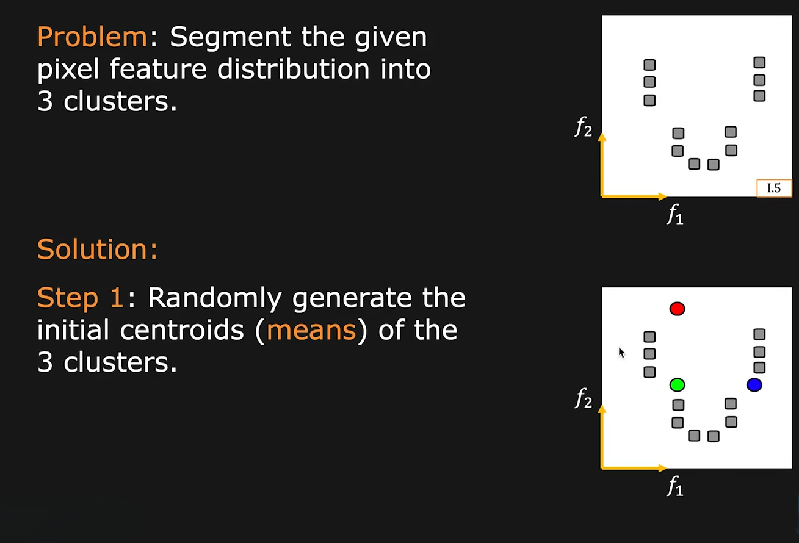
How K-means is Applied in Image Segmentation

Slide 5
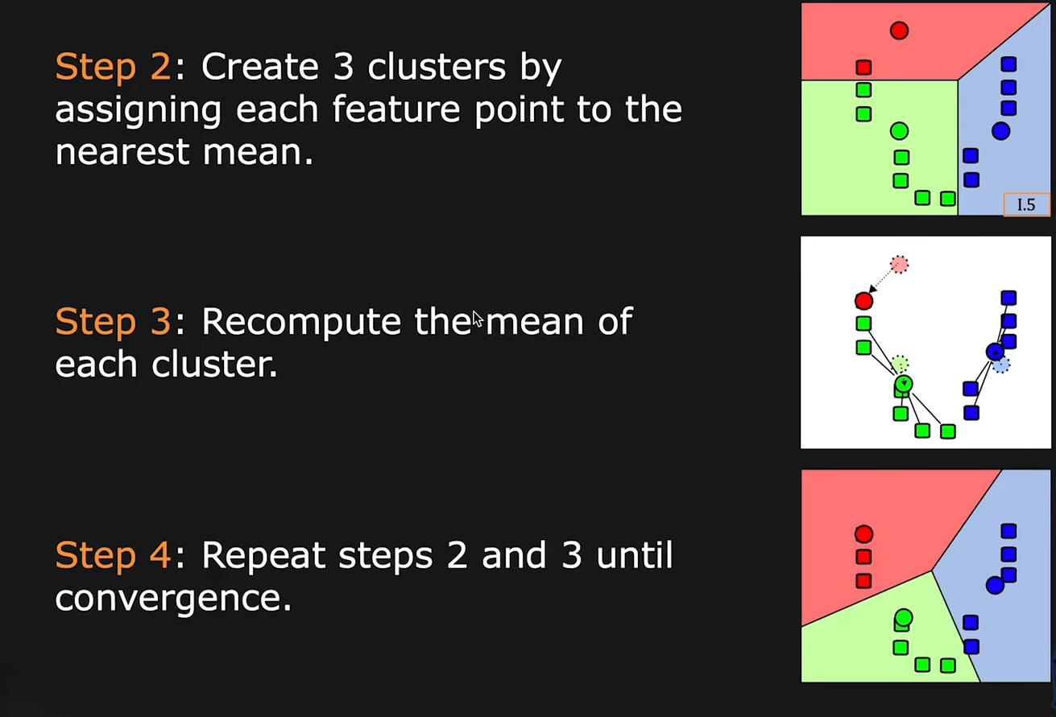
How K-means is Applied in Image Segmentation

Slide 6
Live Demo Preparation
K-means segmentation will be demonstrated live using MATLAB.
Image: brain tumor MRI
Output: segmented tumor region based on selected K value.
Real-time illustration of the segmentation process.

Slide 7
Visual Results for Different K Values
Comparison of segmented images using different K values (e.g., 3, 5, 7, 9).
Lower K: coarser segmentation.
Higher K: finer details but possible over-segmentation.

Slide 8
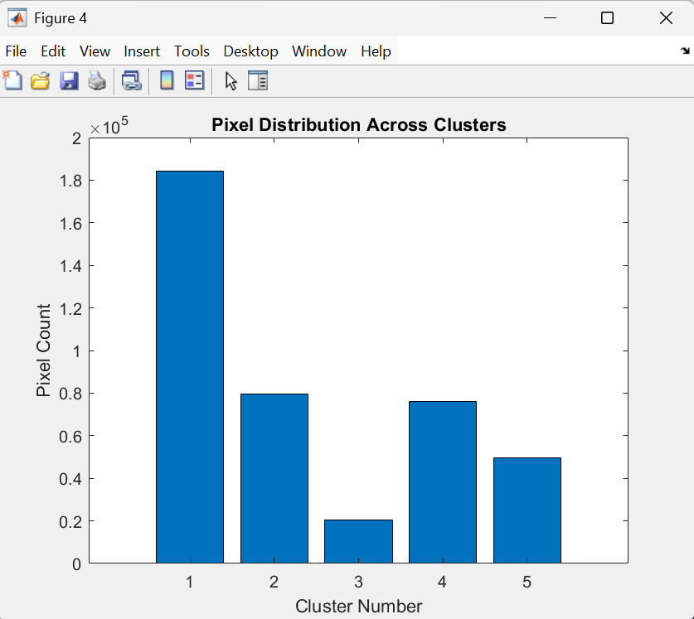
Quantitative Evaluation
Analysis of segmented images:
Pixel distribution across clusters.
Observed segmentation consistency.
Visual clarity of tumor regions.

Slide 9
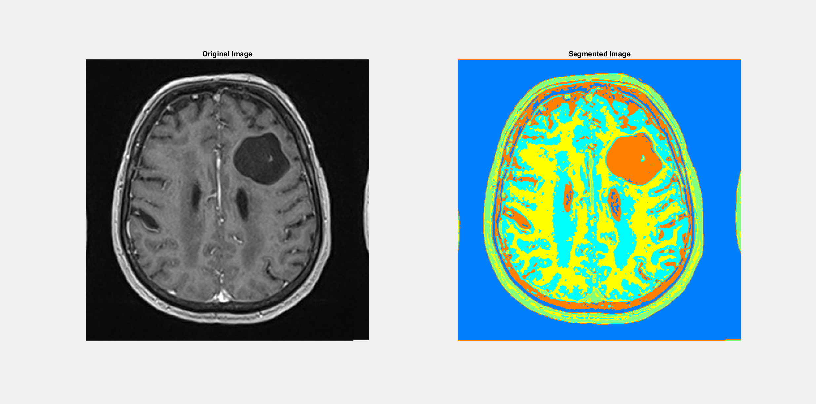
Slide 8: Qualitative Analysis
Visual comparison:
Original MRI image vs. segmented images.
Emphasis on the tumor boundary visibility.
How cluster-based segmentation enhances diagnostic insight

Slide 10
Conclusion
K-means clustering provides a simple, effective technique for brain tumor segmentation.
Effective for unlabeled data and quick implementation.
Key limitation: sensitive to the choice of K.
Future work: compare with advanced methods like deep learning and include labeled ground truth for validation.

